Slide 1


DARS
UPDATES

Slide 2

Content
Memory Refresher
Prototype demonstration
Methodology

Slide 3

1. Updates

Slide 4
Memory Refresher
Topic Modelling
Sequential Pattern mining
LDA
CSPADE
Course Recommender System

Slide 5
2. Prototype

Slide 6
3. Explanation

Slide 7
Topic Modelling
Input Text
Course Manuals
Course Catalogue
Fit Topic Model
Number of topics (5 – 250)
Model Selection
Perplexity
Topic Profile of Student & Course Recommendation
key words
LDA
Log Likelihood
Previous course

Slide 8
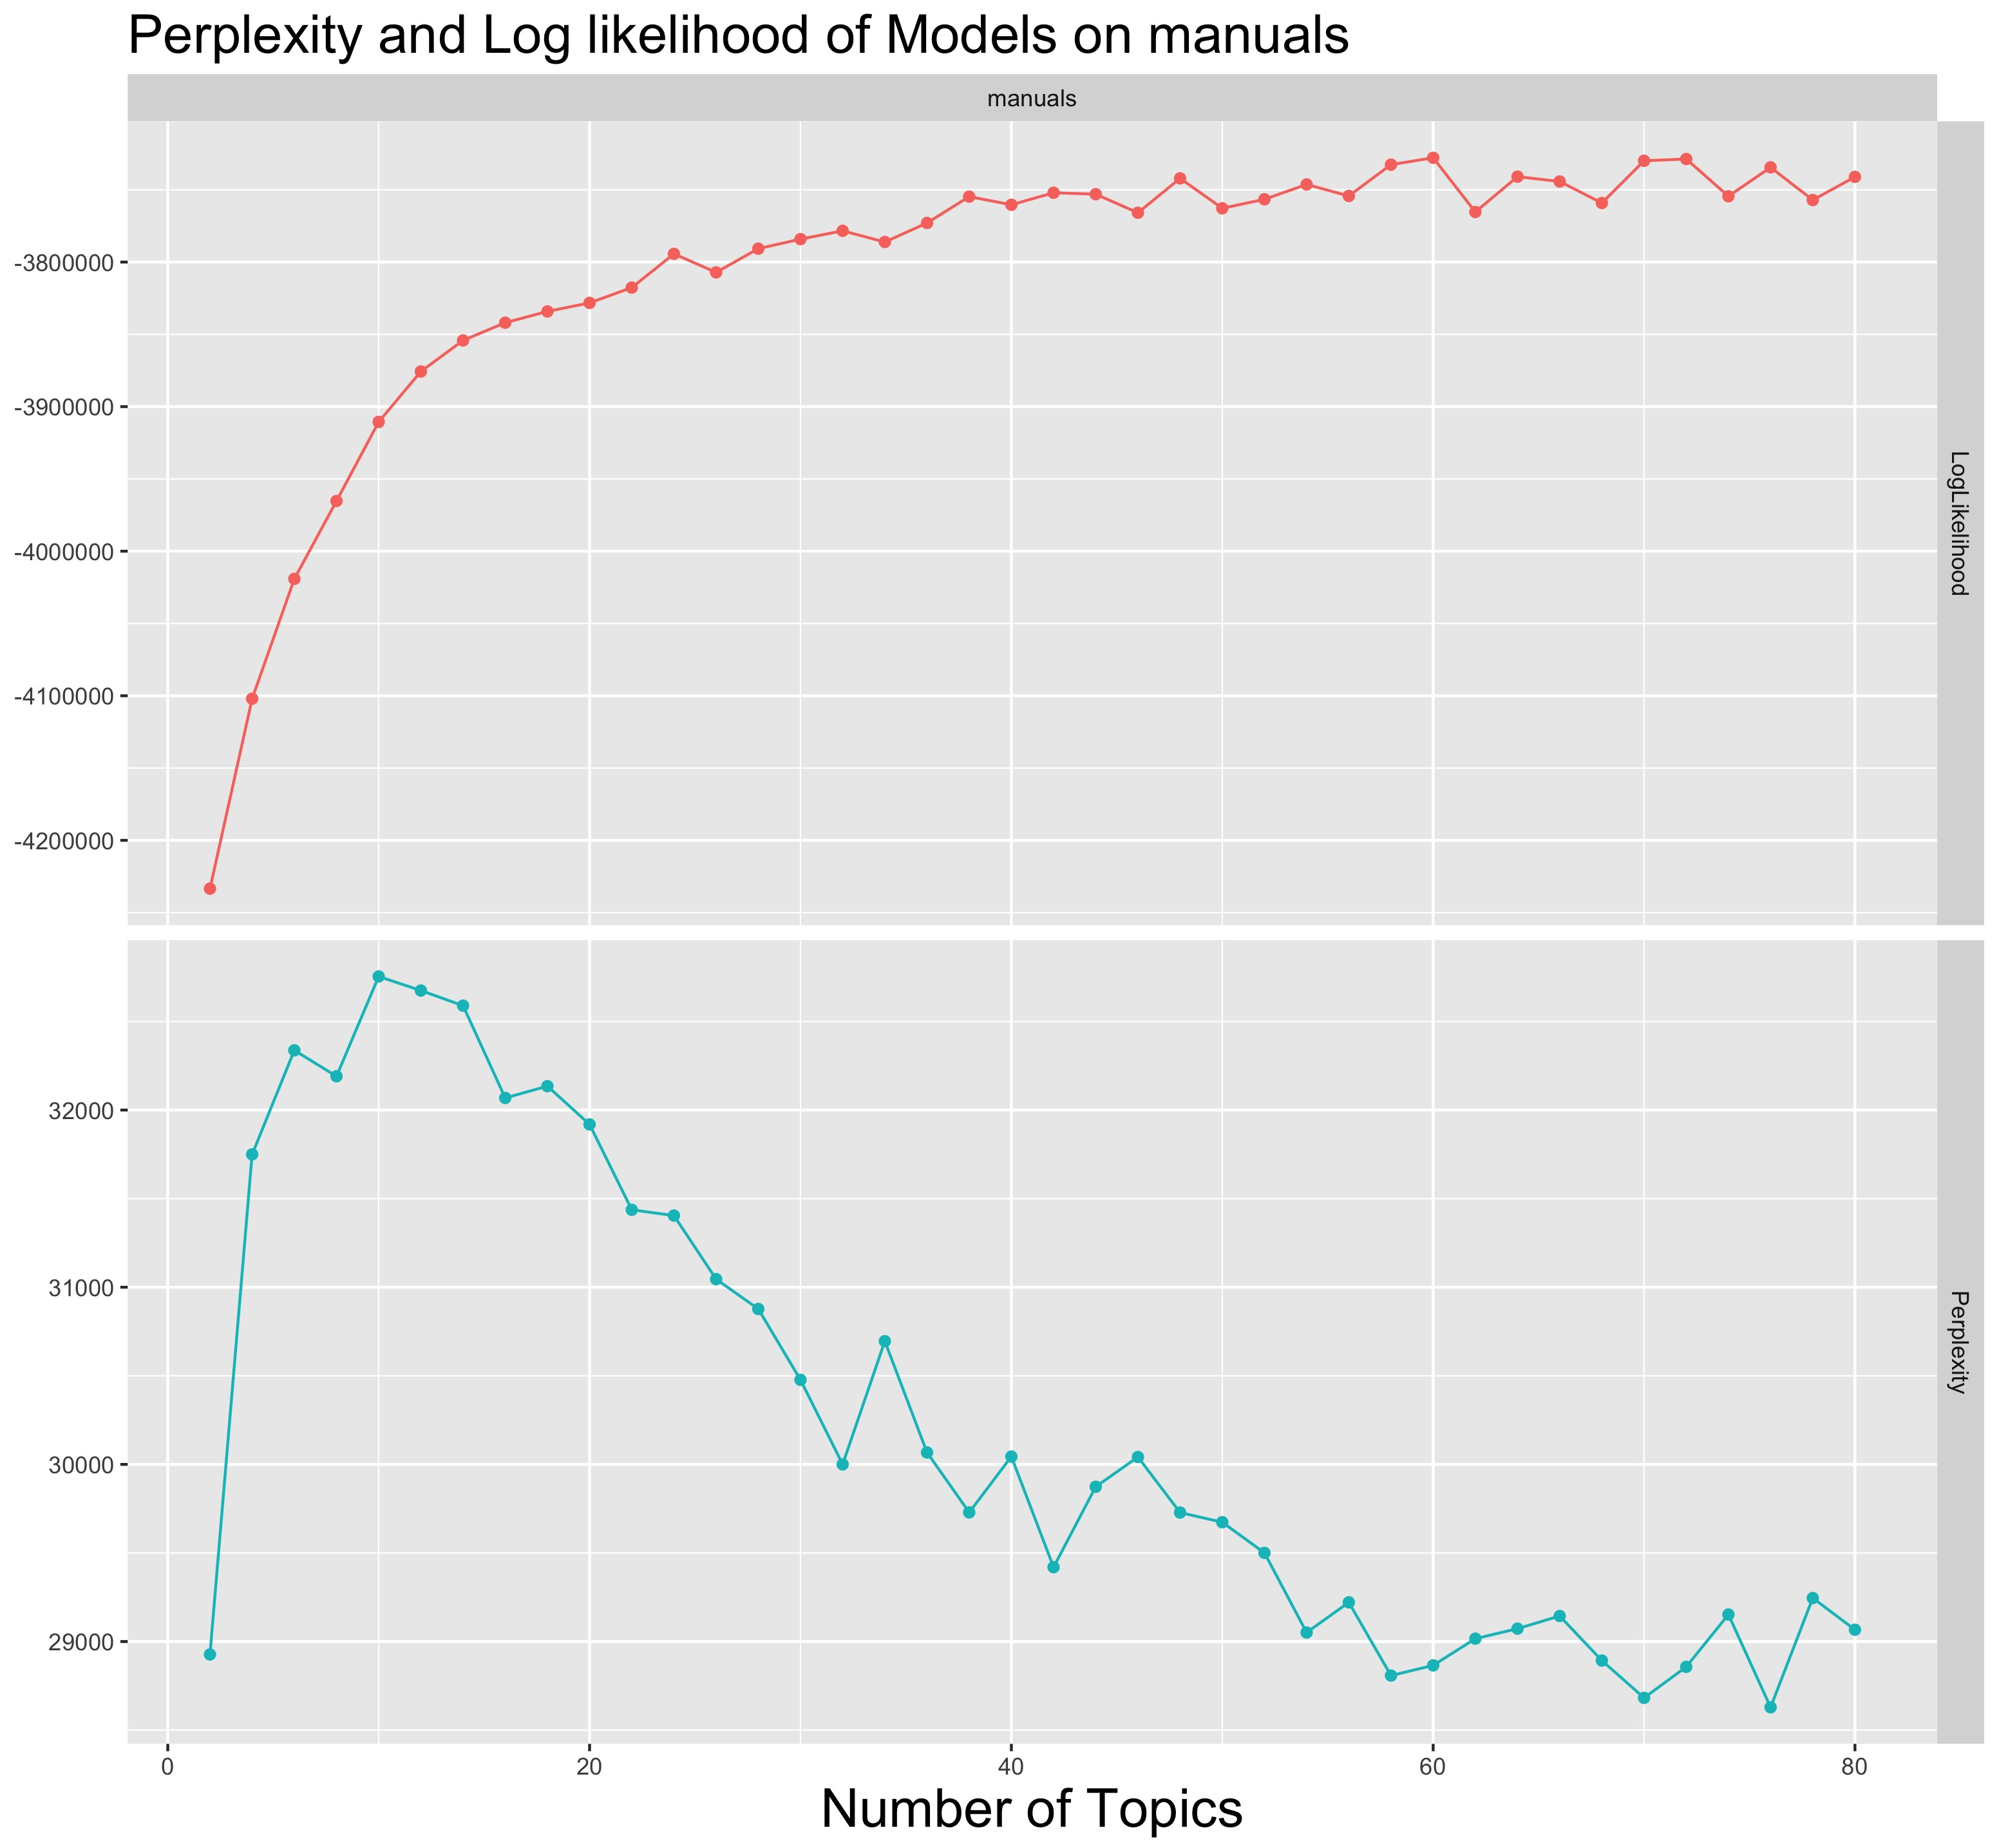
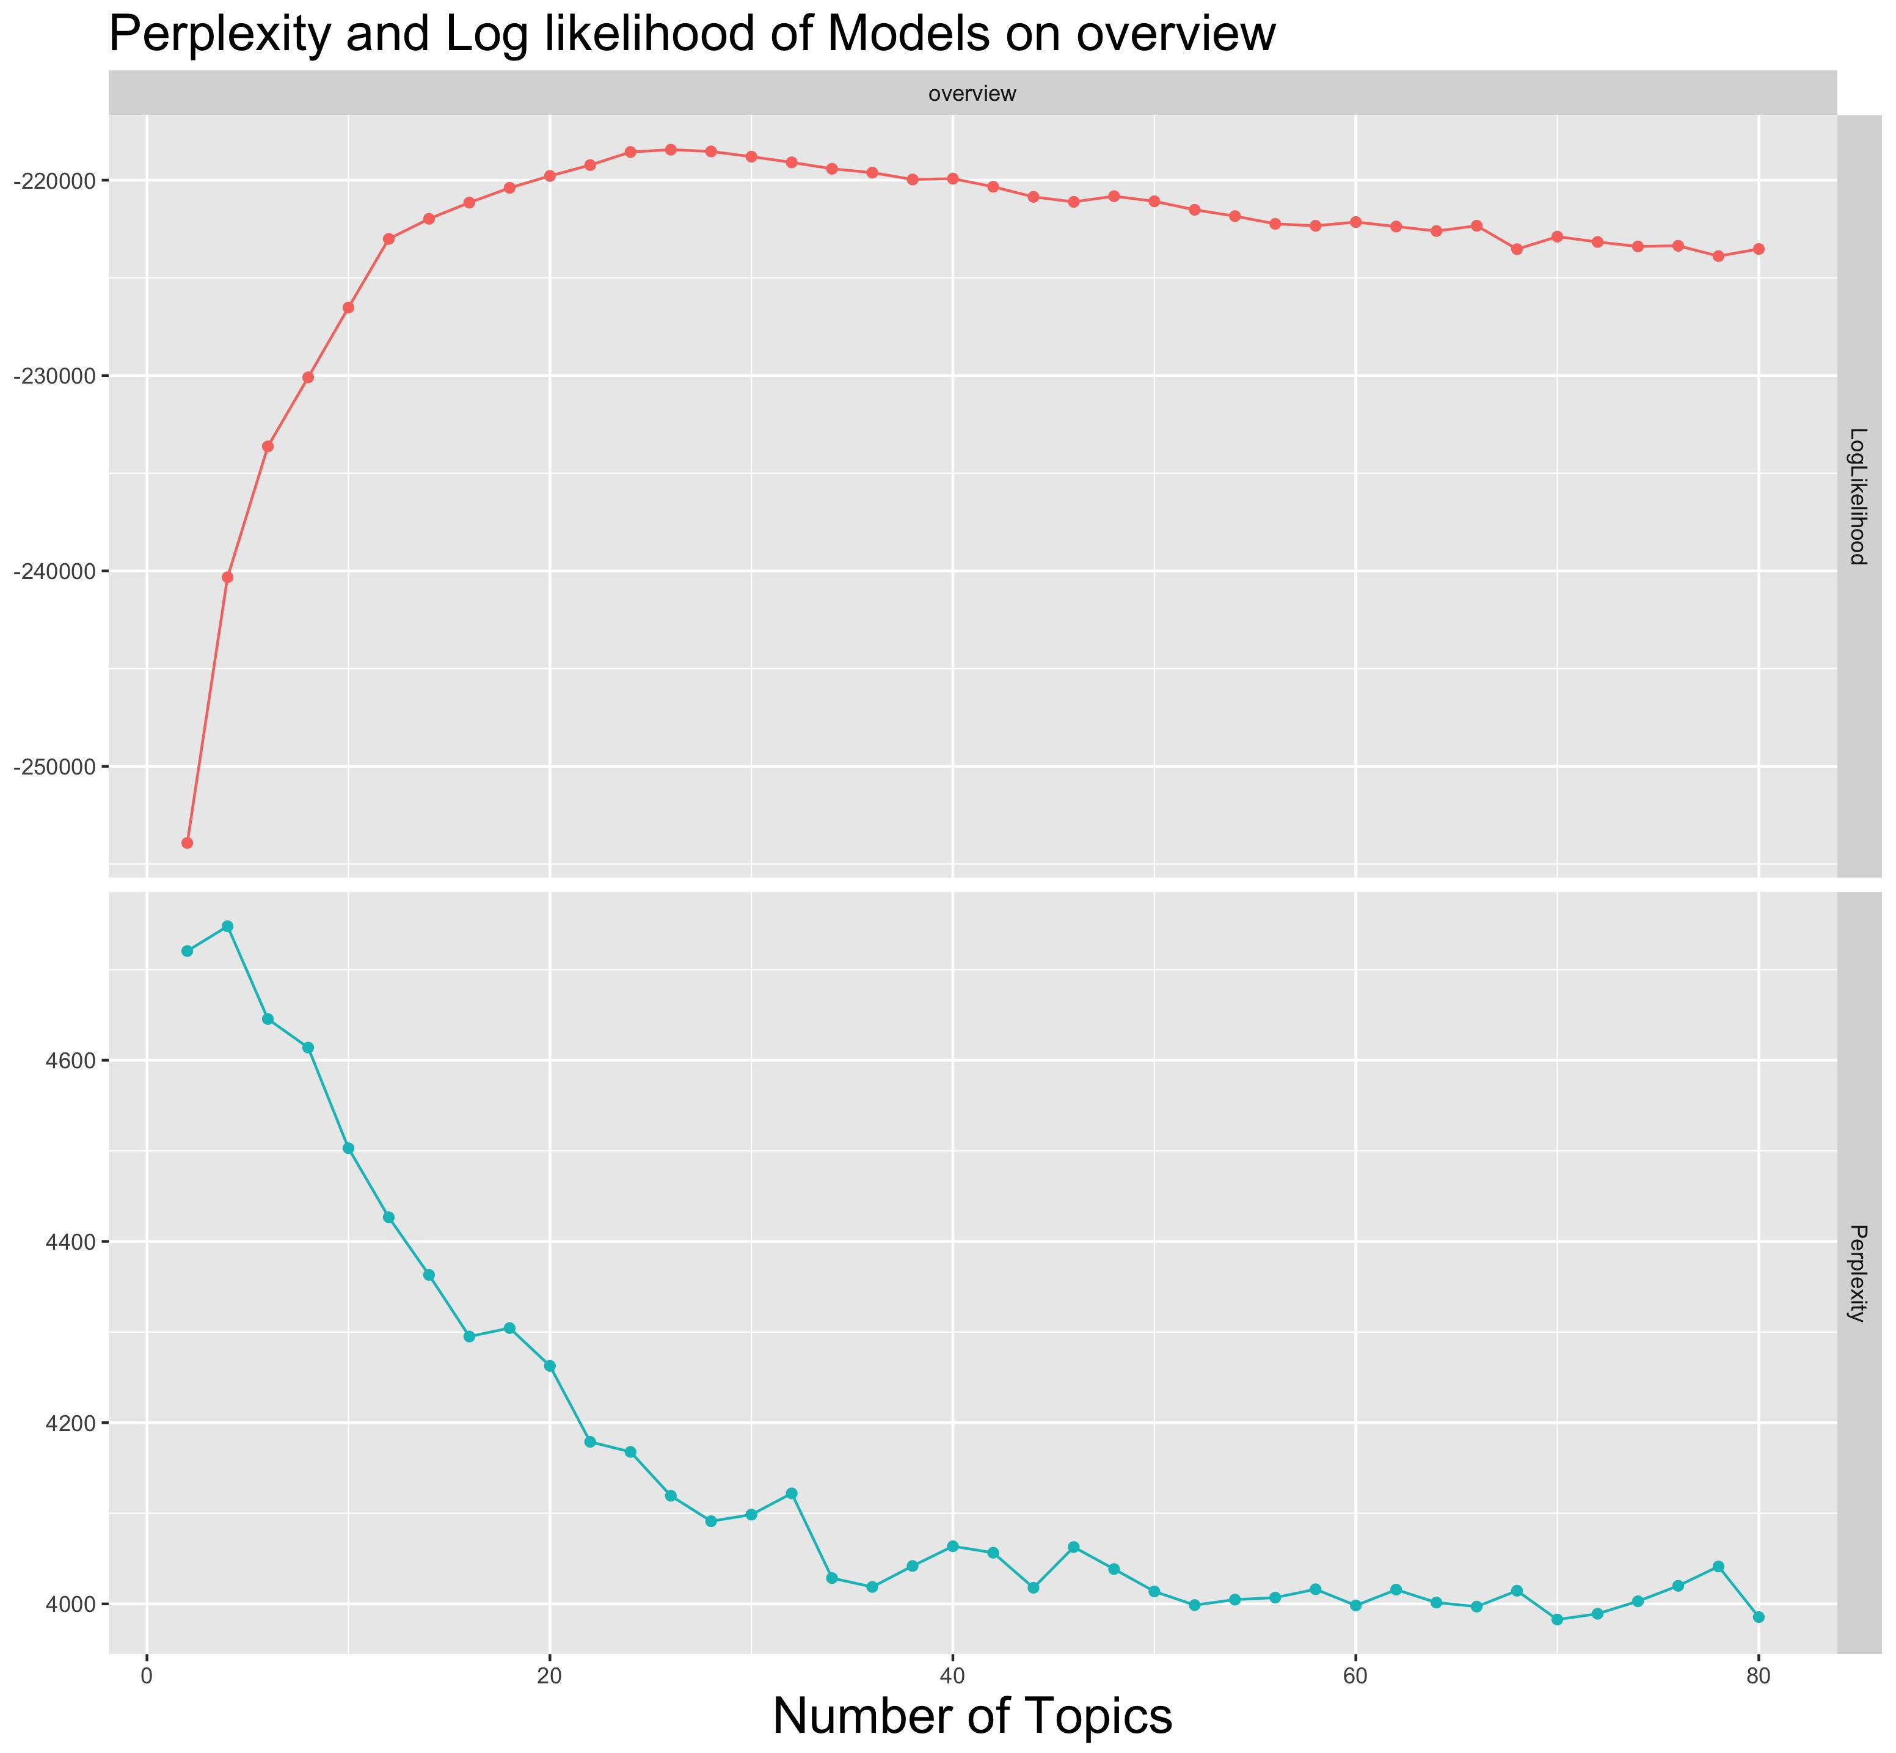
Input Text
Fit Topic Model
Model Selection
Perplexity
Topic Profile of Student & Course Recommendation
key words
Log Likelihood
Previous course

Slide 9
Input Text
Fit Topic Model
Model Selection
Perplexity
Topic Profile of Student & Course Recommendation
key words
Log Likelihood
Previous course
Cross-validation for perplexity is computationally unfeasible.
Perplexity currently computed on training set
Alternative metrics?

Slide 10
Sequence Mining
Input Transcripts
2014-2018
Apply CSPADE
Select Rules
Count > 20
Red flags
Confidence > 0.4
Lift > 1
if FAIL => FAIL
if NOT TAKEN => FAIL

Slide 11
Input Transcripts
2014-2018
Apply CSPADE
Select Rules
Count > 20
Red flags
Confidence > 0.4
Lift > 1
if FAIL => FAIL
if NOT TAKEN => FAIL
Small sample (150 courses, n = 2,500)
Rules have little support
Cold Start Problem
New courses?
Alternative approach?

Slide 12
Thank you!
Sofia Vazquez Alferez
sofia.vazquezalferez@maastrichtuniversity.nl
Raphaël Morsomme
raphael.morsomme@maastrichtuniversity.nl

Slide 13

Stakeholders

Slide 14
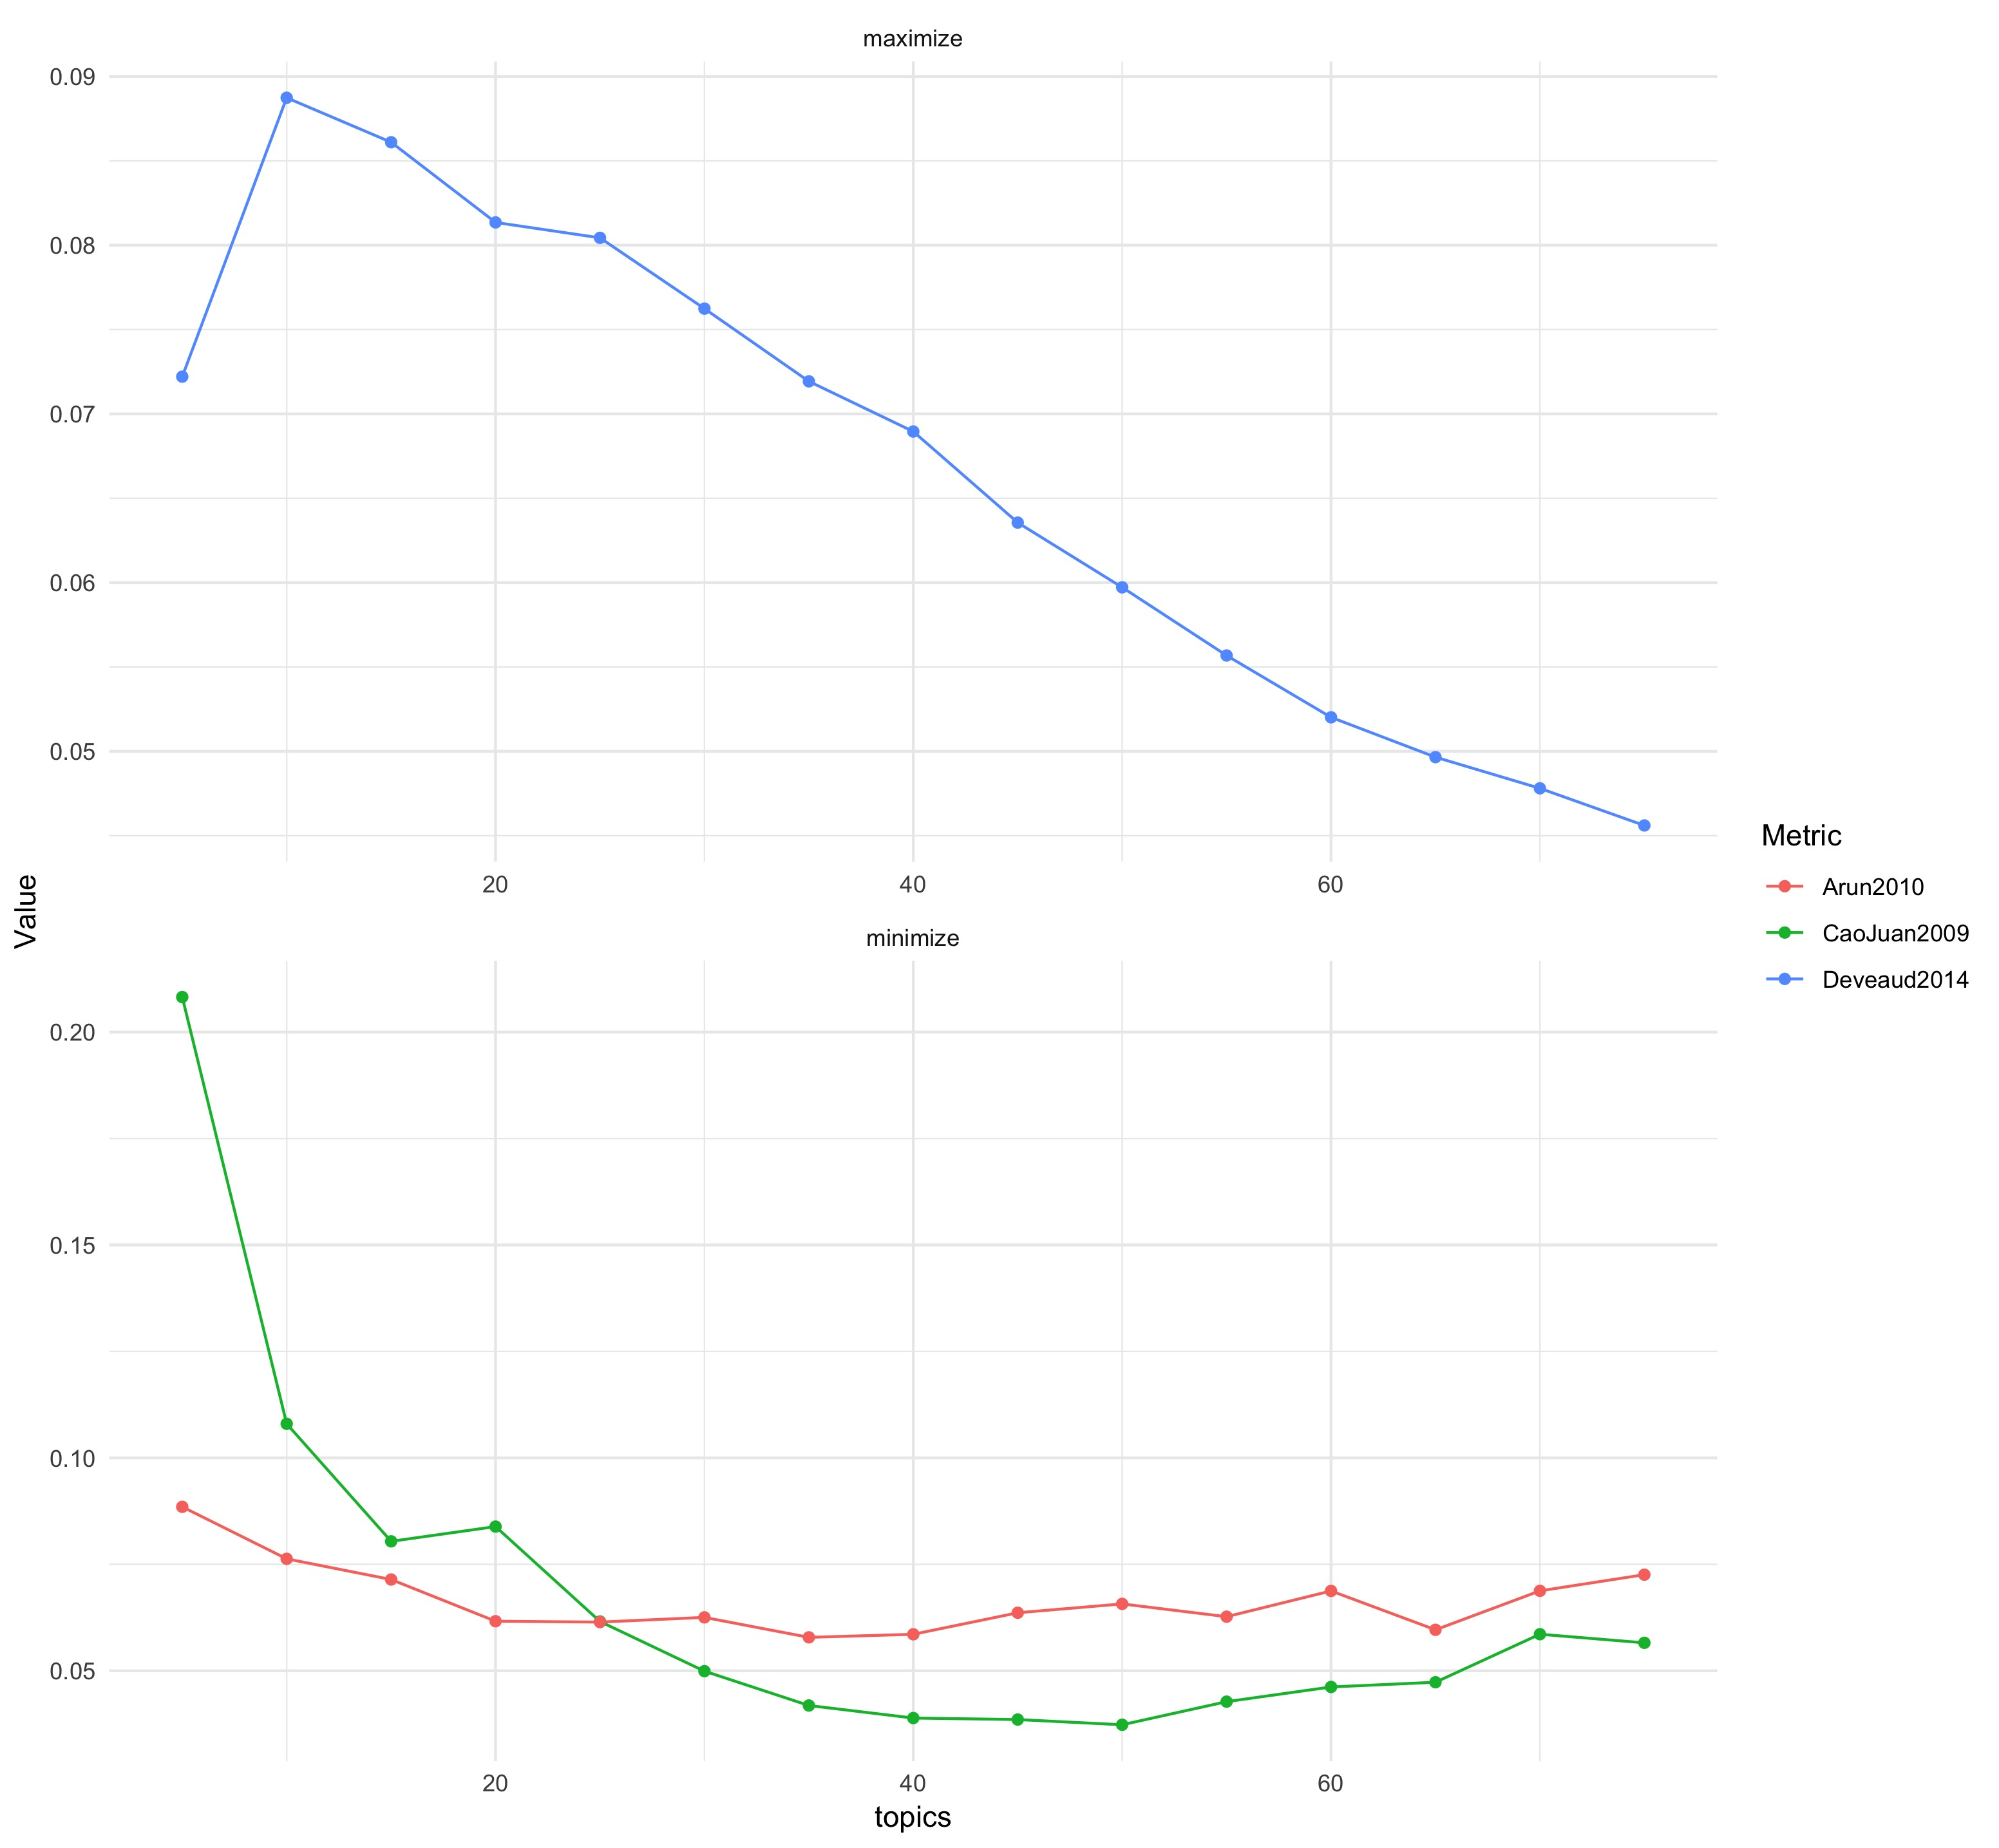
Input Text
Course Manuals
Course Catalogue
Apply LDA
Number of topics from 5 to 250 by 5
Evaluate Performance over n topics
Perplexity
Log Likelihood
Tests
Keep model with ideal number of topics
Clean Text Data
Lowercase
Stemming
Use Beta and Gamma Distributions
Match courses to students

